Slide 1
Comparative Study of Dermoscopic Hair Removal Methods
Lidia Talavera-Martínez
Pedro Bibiloni
Manuel González-Hidalgo

Slide 2
Index
Introduction
Experimental frame
Databases
Hair removal methods
Results
Conclusions

Slide 3
Introduction
Contextualization
Melanoma
Rapidly increasing incidence rate of melanoma and non-melanoma skin cancer.
Melanoma is the 15th most commonly occurring cancer in men and women.
It causes 75% of deaths related to skin cancer.
Dermoscopy
In-vivo, non-invasive skin imaging technique.
It improves the diagnostic accuracy up to 10-30%.
Computer-Aided Diagnosis (CAD) software
Preprocessing
Lesion Segmentation
Feature Extraction and Selection
Classification
Evaluation
Input Dermoscopic Images
- Hair removal
- Contrast enhancement
- Illumination correction
…

Slide 4
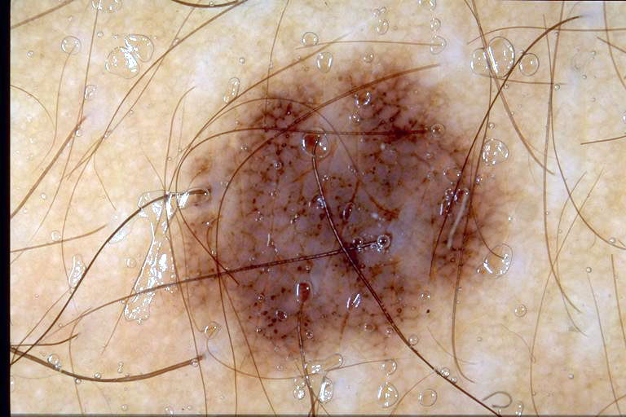
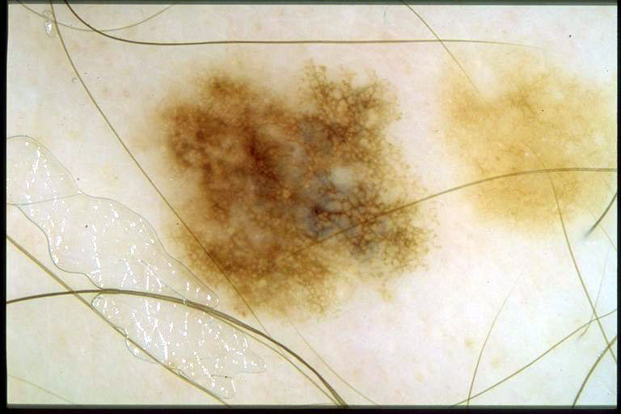
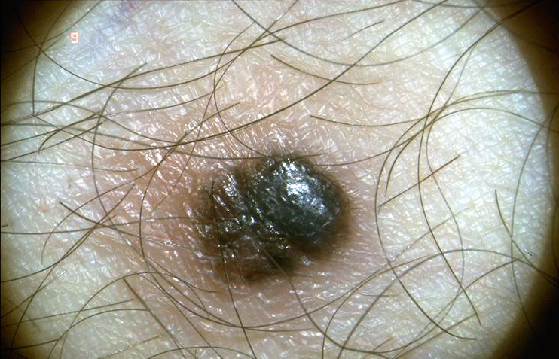
Introduction
Hair removal
Hair detection detects and removes the hair pixels in the image.
Hair restoration estimates the color and texture of the pixels of the skin under the detected hairs, and replaces it.

Slide 5
Introduction
Objective
Goal Compare the performance of different hair removal approaches on dermoscopic images in terms of their similarity with a reference images.

Slide 6
Experimental Frame
Hair Removal Methods
Method | Hair segmentation | Inpainting method
Lee et al. | Grayscale closing | Bilinear interpolation
Xie et al. | Grayscale top-hat | Non-linear PDE
Abbas et al. | Derivative of Gaussians | Coherence transport
Huang et al. | Conventional matched filters | Region growing algorithms and linear discriminant analysis
Tossi et al. | Canny edge detector | Coherence transport
Bibiloni et al. | Color top-hat | Morphological inpainting

Slide 7
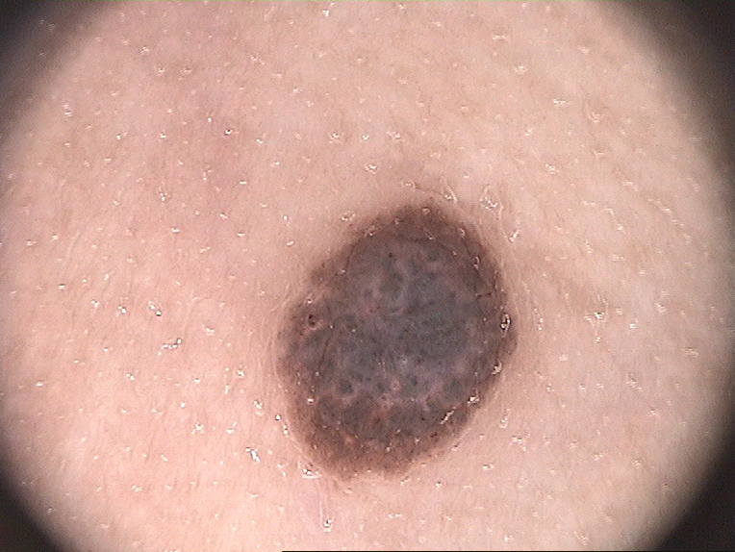
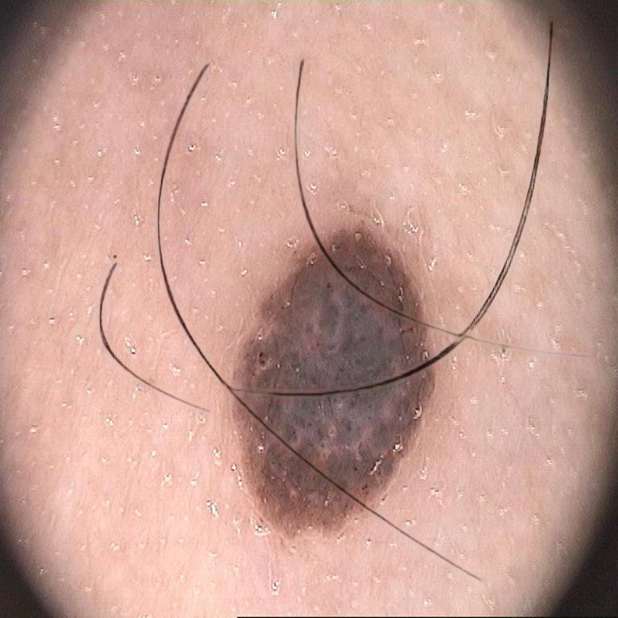
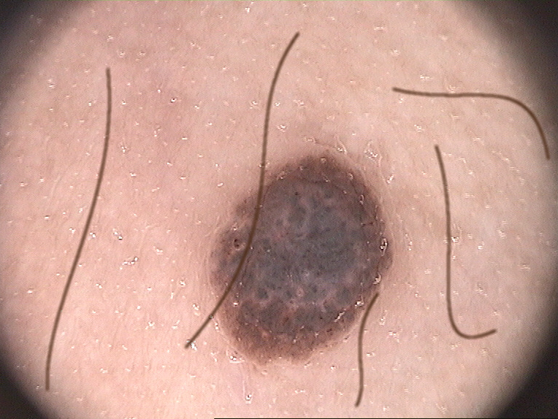
Experimental Frame
Reference image: 13 dermoscopic hairless images of the PH2 dataset.
Simulated hair
DB GAN: method based on generative adversarial networks by Attia et al.
DB SIM: HairSim software, implemented by Mirzaalian et al.
Databases
Reference image
DB GAN
DB SIM

Slide 8
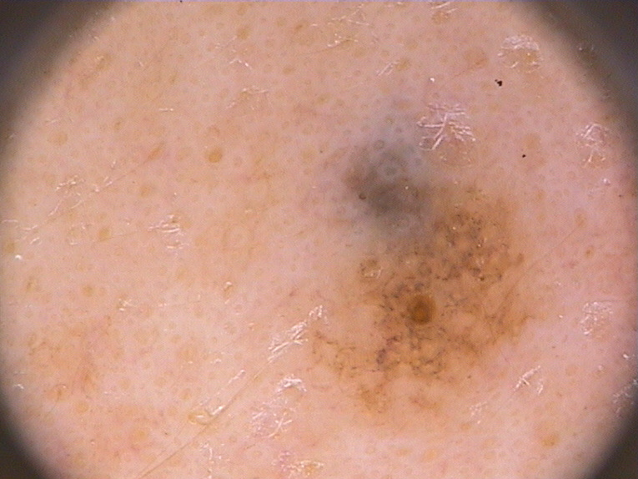
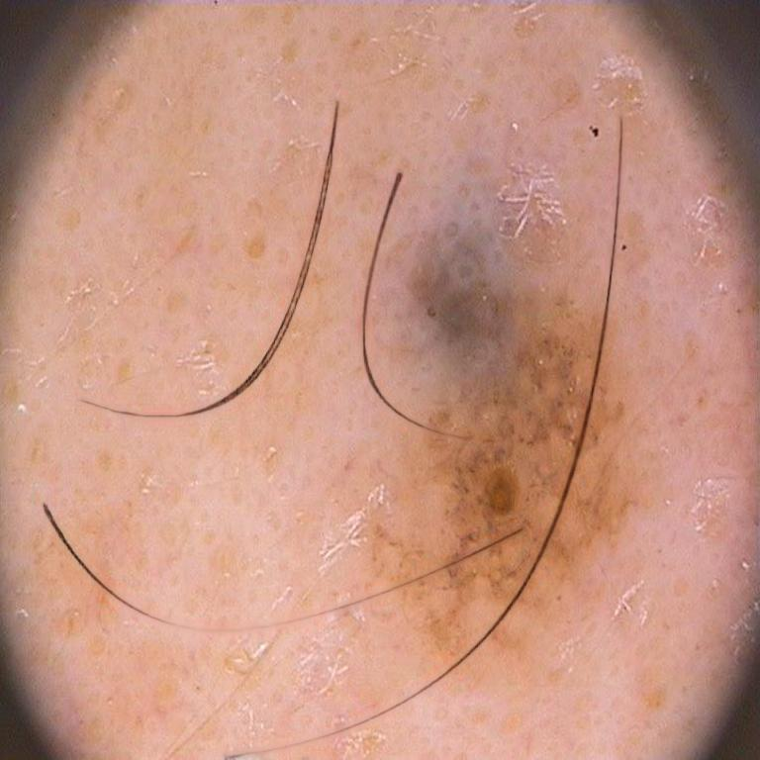
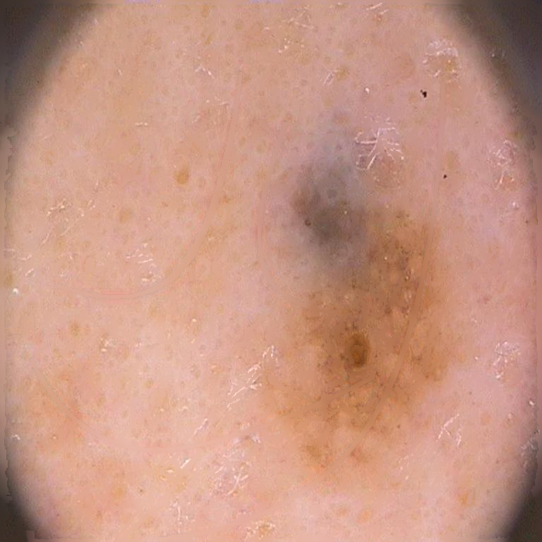
Results
Qualitatives
Reference image
GAN hair simulation
Lee
Xie
Abbas
Huang
Tossi
Bibiloni

Slide 9
Results
Quantitatives
Objective performance measures of similarity
Mean Squared Error (MSE)
Peak Signal-to-Noise Ratio (PSNR)
Root Mean Squared Error (RMSE)
Structural Similarity Index (SSIM)
Multi-Scale Structural Similarity Index (MSSSIM)
Universal Quality Image Index (UQI)
Visual Information Fidelity (VIF)
PSNR-HVS
PSNR-HVS-M
Statistical study
T-test if the samples pass de normality test, or if not, the Wilcoxon Signed-Rank test.
Pixel to pixel.
Statistical features locally and then combine them.
Based on the perception of the Human Visual System (HVS).

Slide 10
Results
Quantitatives
 |  | MSE | SSIM | PSNR | RMSE | VIF | UQI | MSSSIM | PSNR-HVS-M | PSNR-HVS
Abbas vs. Huang | p-value | 2.10e-02 | 0.382352 | 0.007884 | 1.21e-02 | 8.77e-03 | 6.21e-03 | 2.21e-01 | 5.88e-03 | 6.56e-03
 | Statistical test
The mean of Abbas' algorithm is worse than that of Huang's algorithm.
We can not rule out the equality of their means, but the mean of Abbas' algorithm is statistically better than that of Huang's algorithm
The mean of Abbas' algorithm is better than that of Huang's algorithm.

Slide 11
Conclusions
All measures points to the algorithm presented by Xie et al. as the best one.
Lee's algorithm vs. Bibiloni's algorithm:
Statistically better with regard to the SSIM, VIF and MSSIM.
Cannot rejected that the two methods have a statistically equivalent performance for the rest of the measurements.
Bibiloni et al. surpasses the Huang’s algorithm statistically.
The Abbas' and Toossi's algorithms produce the least suitable results.
Do not seem to distinguish well hairs of greater thickness or dark colors.
Future work
Expand the number of images used in the datasets.
Improve the quality obtained by hair simulation methods.

Slide 12
Acknowledgments
This work was partially supported by the project TIN 2016-75404-P AEI/FEDER, UE. L. Talavera-Martínez also benefited from the fellowship BES-2017-081264 conceded by the Ministry of Economy, Industry and Competitiveness under a program co-financed by the European Social Fund.

Slide 13
THANK YOU

